Slide 1



OPAL Tools
Free Tools for Oracle Software Development
Dietmar Aust Opal-Consulting, Cologne
www.opal-consulting.de
Notes:
I am going to tell you a story of simplicity and robustness.
For the demo use:
- virtual machine, screen resolution: 1600x1200
125% scale mode

Slide 2

Are you happy with your deployment strategy?
Issues when you moving code changes (APEX, ORDS, PLSQL) from development to test and production
All changes deployed, did we miss anything?
Compile errors? Install dependent objects last!
When did we install what?
Notes:
When you move code changes (APEX, ORDS, PLSQL) from one development to test and production …. What does your strategy feel like?
Are you sure that you have deployed ALL of the changes? And not forgotten anything?
Are you sure that all of the depencies will install in the right order?
Are you sure that there are no compile errors / invalid objects in the end?

Slide 3

A new solution
Automatically run sql scripts in the desired order
Don't manually code your release - configure it
Automatic logs (file/database)
Highly configurable
No separate tools, SQLcl embedded (APEXExport, REST export)
Notes:
When you move code changes (APEX, ORDS, PLSQL) from one development to test and production …. What does your strategy feel like?
Are you sure that you have deployed ALL of the changes? And not forgotten anything?
Are you sure that all of the depencies will install in the right order?
Are you sure that there are no compile errors / invalid objects in the end?

Slide 4
Single Requirement
All changes are deployed through files!!!

Slide 5
Demos

Slide 6
Benefits
You don‘t have to BUILD a patch/release, it is already there
Others „build“ a patch at the end of the release cycle
We create files already in the right location or copy them to the right destination
Connection pools are already set up, you cannot install into the „wrong“ environment

Slide 7
The Solution
The software:
Written in Java + (generated) batch scripts
Works on Windows, MacOS and Linux
Exporter leverages DBMS_METADATA and SQLcl
Installer leverages SQLcl (binaries already included !)
Tools can be used together … OR separately
Java application opal-export
Java application opal-install
DBMS_METADATA
SQLcl
SQLcl

Slide 8
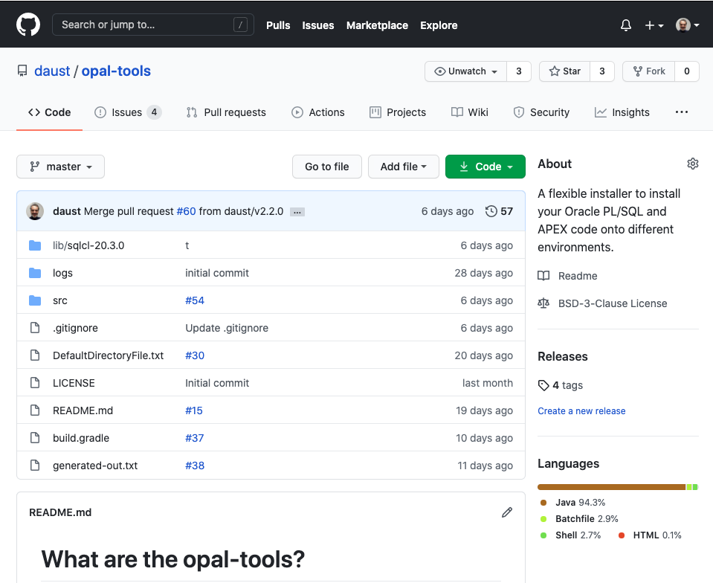
https://github.com/daust/opal-tools

Slide 9
Artwork used
IIstudio/Bigstock.com: 391193441
sidarta/Bigstock.com: 266092933

